Slide 1


Slide 2
Discrete Mathematics

Slide 3
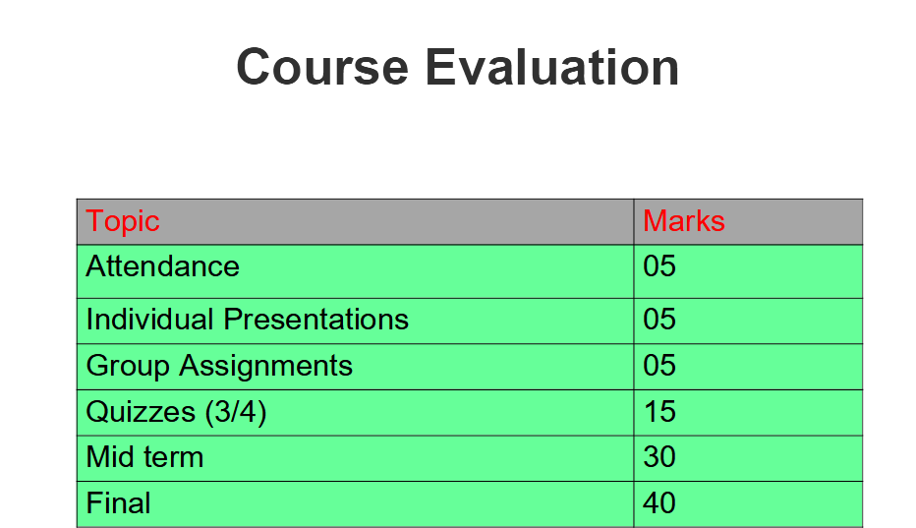

Slide 4
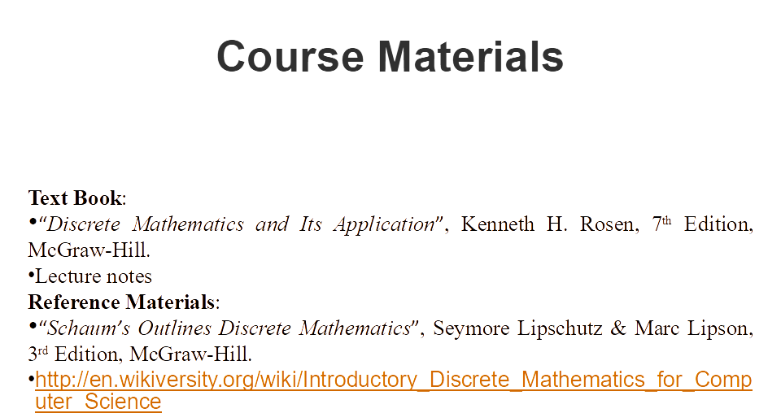

Slide 5

Discrete
or
Continuous ???

Slide 6

Discrete
or
Continuous ???

Slide 7
Discrete Data
specific, distinct values,
can be counted
the number of students in a classroom
the number of cars in a parking lot
the results of rolling a die (1, 2, 3, 4, 5, or 6)
Continuous Data
can take on an infinite number of values within a given range
can be further divided into smaller and smaller increments
there are no gaps or discontinuities between values
height, weight, temperature, time

Slide 8
Natural Number
a set of positive counting numbers.
start from 1 and continue indefinitely: 1, 2, 3, 4, 5, ...
Real Numbers
include natural numbers, whole numbers, integers, fractions, decimals, and all other numbers that can be represented.
both finite and infinite decimal expansions.
How many Natural Numbers in between 1 and 4 ???
How many Natural Numbers in between 1 and 2 ???
How many Real Numbers in between 1 and 4 ???

Slide 9
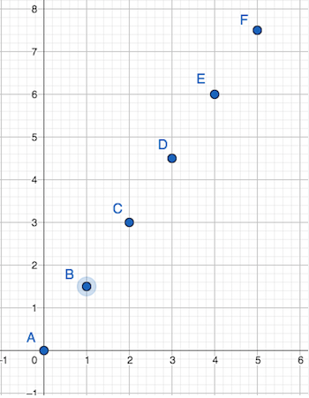
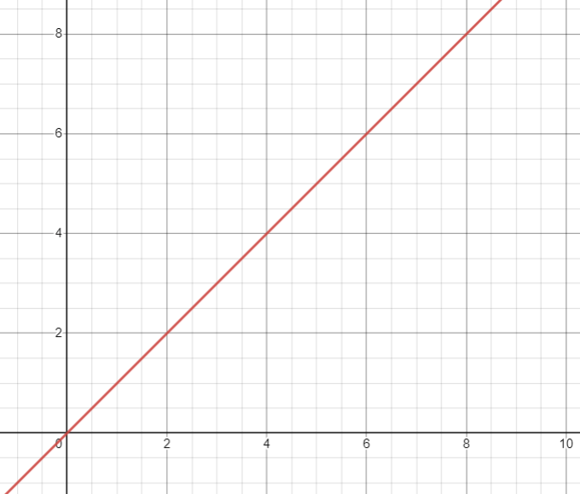
For Natural Number : 1, 2, 3, 4, ...
For Real Numbers: 0.001,0.0001, 0.00001 … , 1, …, 1.001, 1.0001
Discrete Graph
Continuous Graph

Slide 10
What is Discrete Mathemetics ?
it deals with discrete, distinct, or separate objects and structures
the concepts of discrete mathematics are not continuous
focuses on concepts like integers, sets, graphs, logic, and combinatorics
continuous mathematics that deals with real numbers, calculus, and functions.

Slide 11
Why we call it 'Discrete Mathematics' ?

Slide 12
few key reasons:
Countable Objects:
focuses on countable objects.
For example, we can count
the elements in a set,
the vertices in a graph,
or the integers between two values.
Distinctness:
each element or object is distinct and separate from others
For example, when dealing with sets, each element within the set is considered a distinct entity.
Discrete Decision Making:
Logic and Boolean algebra involve discrete decision making,
Decisions can be either true or false, with no intermediate values.

